Slide 1
PROJECT TITLE
CAPSTONE PROJECT
Presented By:
Student Name : Siddhant Hanumant Pawale
College Name & Department : NUTAN COLLEGE OF ENGINEERING & RESEARCH ,Artificial intelligence

Slide 2
OUTLINE
Problem Statement
Technology used
Wow factor
End users
Result
Conclusion
Git-hub Link
Future scope

Slide 3
Problem Statement
Develop a system to securely hide a secret message (text or file) within an image using steganography, ensuring the message is undetectable and easily extracted by authorized users. The system should allow embedding and extraction without compromising image quality and optionally provide encryption for added security.

Slide 4
Technology used
Programming Language: Python
Libraries:
Pillow (for image processing)
Stegano (for embedding hidden messages)
cryptography (for optional encryption)
Platform: Windows/Linux/Mac
Web Framework (Optional): Flask/Django (for web-based tools)

Slide 5
Wow factors
Image-based Steganography: Hides messages within images without compromising quality.
Encryption Option: Adds an extra layer of security by encrypting hidden messages.
User-Friendly: Simple interface for easy embedding and extraction, requiring no technical expertise.
Cross-Platform: Works across major operating systems (Windows, Linux, Mac).
Fast & Efficient: Quick processing of embedding and extraction with minimal performance impact.

Slide 6
End users
Privacy-Conscious Individuals: People who want to securely share sensitive information without detection.
Security Professionals: Experts who need to hide data for secure communications.
Digital Forensics Teams: Professionals who analyze digital evidence and detect hidden messages.
Journalists/Whistleblowers: Individuals needing a covert way to share sensitive information safely.
Developers: Who may integrate steganography into larger security systems.

Slide 7
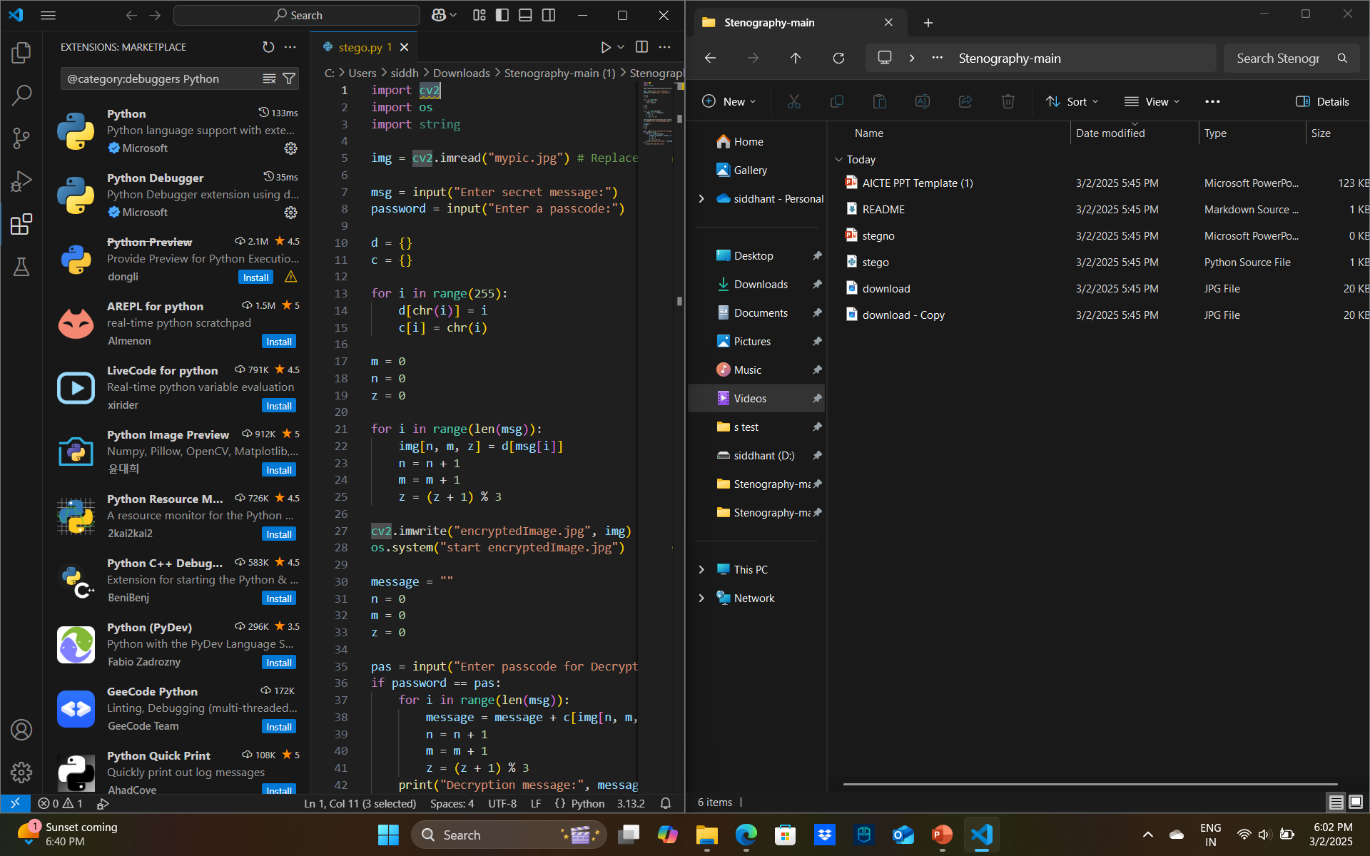
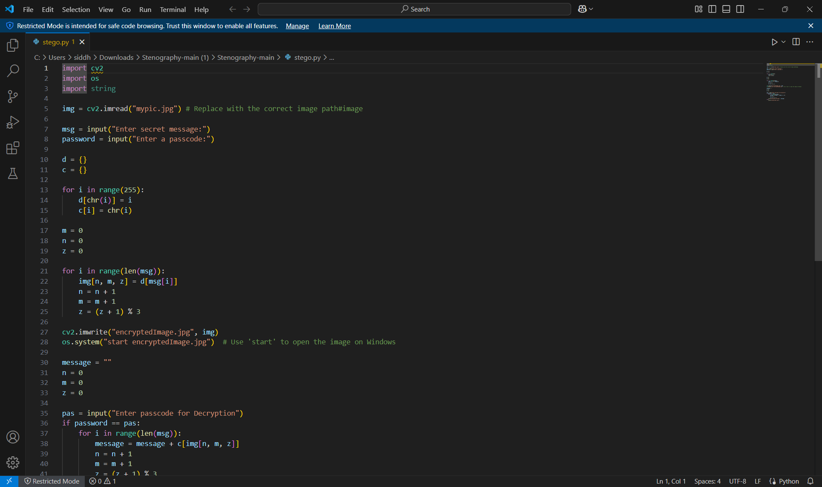
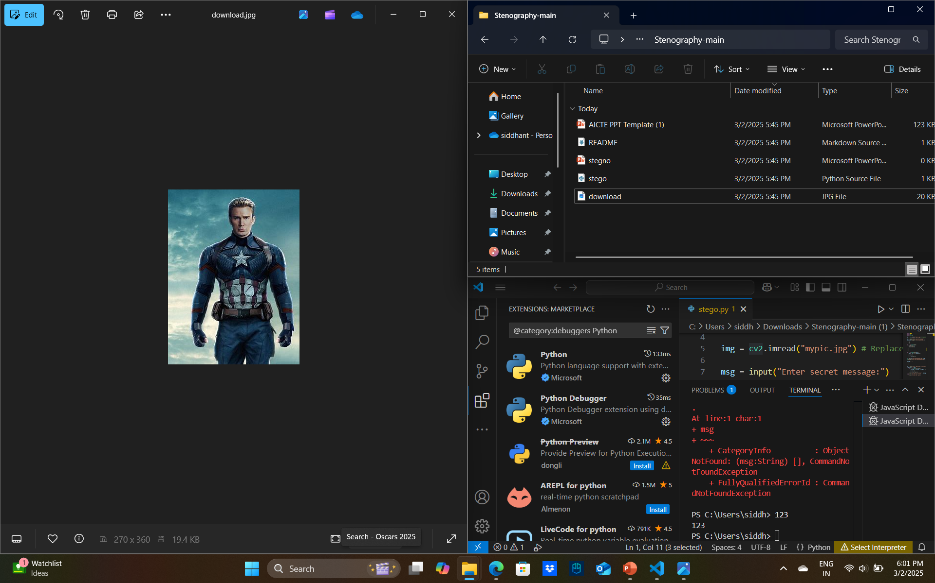
Results

Slide 8
Conclusion
In conclusion, this project successfully addresses the need for secure, covert communication through steganography. By developing a system that hides secret messages within images, we ensure that the messages remain undetectable to the human eye and easily retrievable by authorized users. The optional encryption adds an extra layer of security, making the system more robust against unauthorized access. With a user-friendly interface and support for multiple platforms, this project stands out as a practical solution for privacy-conscious individuals, security professionals, and anyone needing secure communication

Slide 9
GitHub Link
https://github.com/sidp3/Stenography

Slide 10
Future scope(optional)
Support for More File Formats: Expanding the tool to support additional file formats (audio, video) for more versatile steganography applications.
Advanced Encryption Techniques: Implementing stronger encryption algorithms (e.g., AES) for enhanced security of the hidden messages.
Real-Time Detection and Prevention: Developing features to detect and prevent steganography-based attacks in security systems.
Cloud Integration: Allowing users to store and share encrypted, steganographically hidden messages via cloud platforms.
Mobile Application: Developing mobile apps for both Android and iOS to provide easier access to steganography on the go.

Slide 11
THANK YOU

